Slide 1
WANDER
Assets

Slide 2
TEEPEE FRAMES X 38 (40 - 2 need repairing)
Covers damaged all need to be replaced circa 900 USD PP

Slide 3
TEEPEE SET UP
Teepees can be set up in different configurations to suit

Slide 4
MATRESSES & LINENS ( VARIOUS ) PALLETT BASES–
TO BE VERIFIED - Originally bedding and matresses for at least 100 pax

Slide 5
MISC ITEMS
TO BE VERIFIED

Slide 6
CONTAINER BATHROOMS
FEMALE
4 TOILETS
4 SHOWERS
VANITY WITH 3 SINKS
MENS –
2 TOILETS
3 URINALS
4 SHOWERS
VANITY WITH 3 SINKS

Slide 7
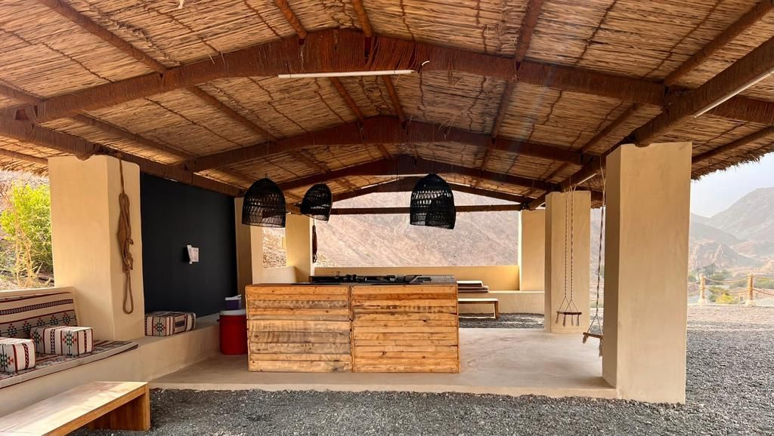
BAR :
Pallett bar 6 pcs
Marble top
Back bar with sink
Small DB
Glassware etc
Barrel tables etc
Under bar fridge
TO BE VERIFIED

Slide 8
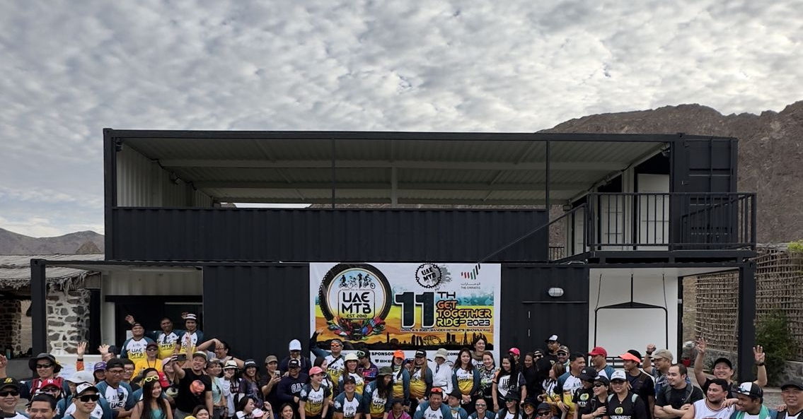

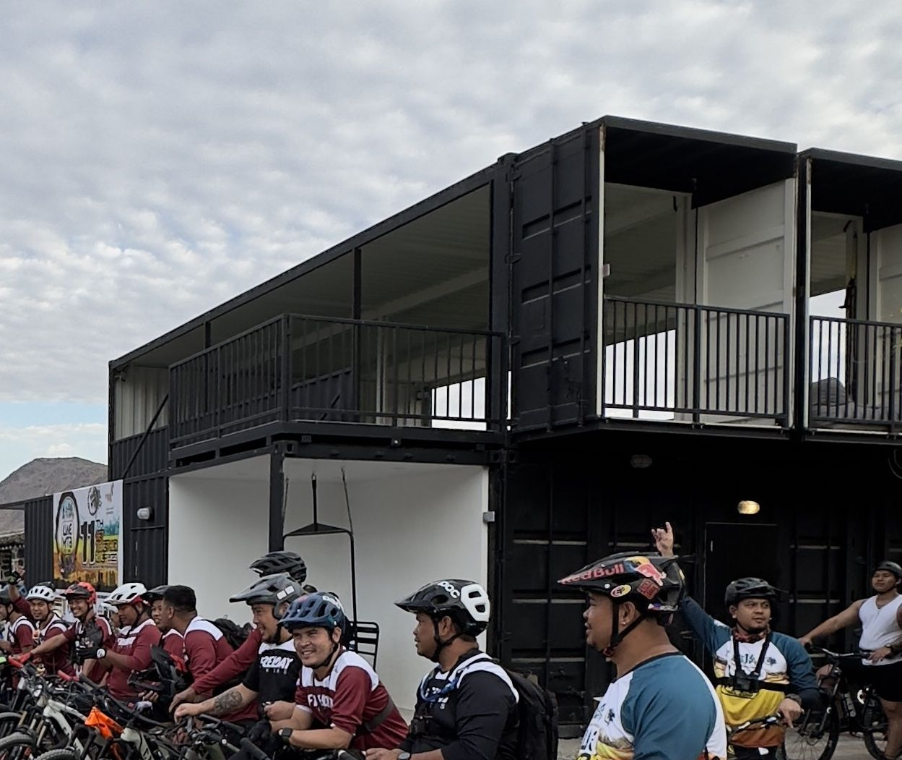
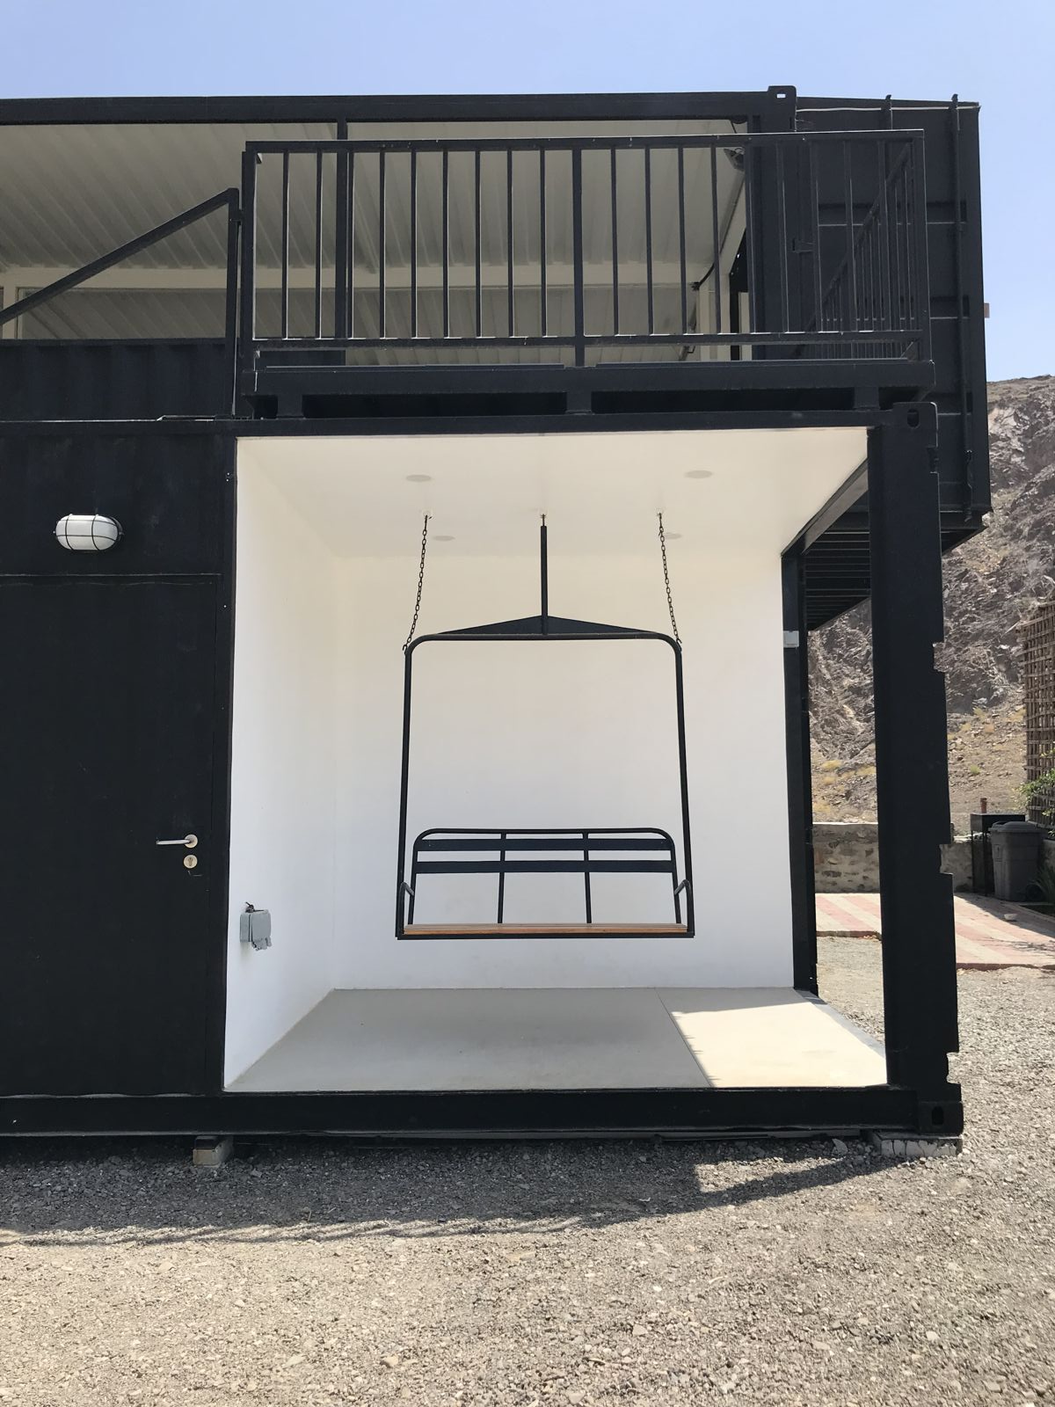
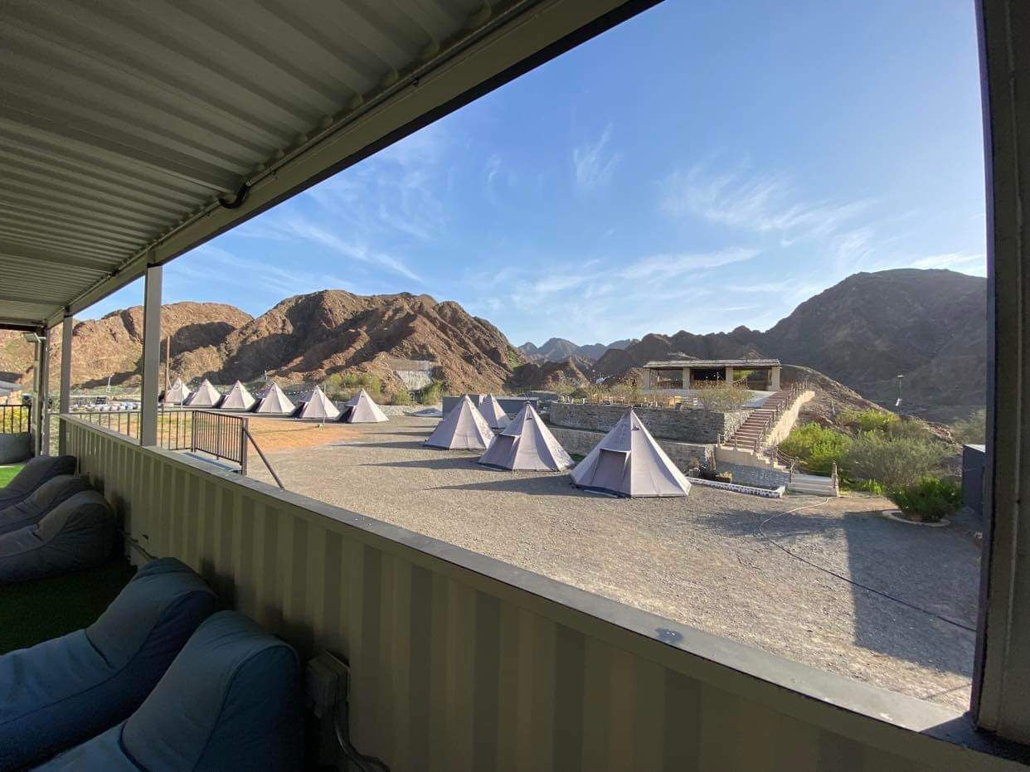
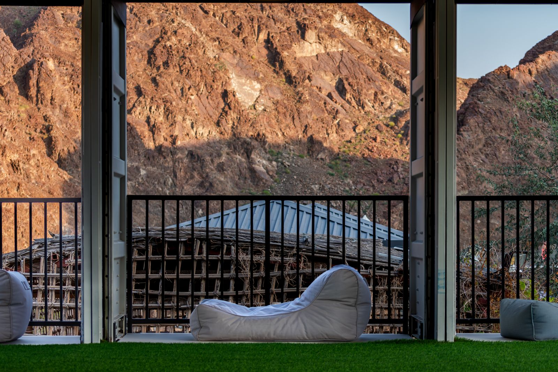
KITCHEN TOP DECK UNIT :
Unit is made up of 3 x 40ft lower containers
Another 40ft container being the stairs up to the top deck with storage under
Three more containers make up the top deck all of which is open with railings
and “Juliet “balconies to the side.
Insulated – water and power to lower levels.
This was damaged in the fire and needs extensive electrical re wiring and new paint.

Slide 9
Others :-
STAFF ACCOMMODATION
40ft modified container ( insulated )
4 cabins with A/C individual door entrances.
1 bathroom – shower/ toilet/sink – own entrance door
STORAGE CONTAINER
40ft modified container with power and AC (insulated )

Slide 10
Items owned by Vren

Slide 11
PORTABLE TOILETS & SHOWER UNITS – owned by Vren
UNIT 1 - MENS – TOILETS X 4
UNIT 2 - MENS - SHOWERS X 4
UNIT 3 - FEMALE - TOILETS X 4
UNIT 3 - FEMALE- SHOWERS X 4

Slide 12
FOOD TRUCK. Owned by Vren – new registration
SS sink and worktop
SS counters x 2 – space under
Coffee machine – 1 pull & grinder
Under counter fridge
Microwave
Kettles x 2
Double tier Pizza machine
Various other cooking items

Slide 13
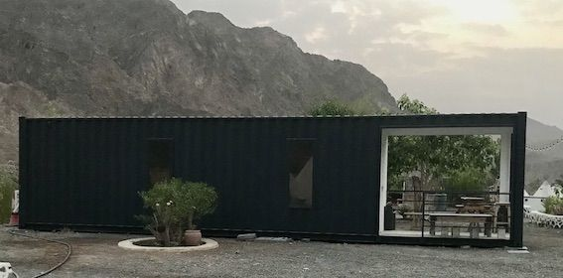
Reception container – owned by Vren
Open space of 30 ft
with cutout verandah ogf 20 ft
Cctv monitor

Slide 14
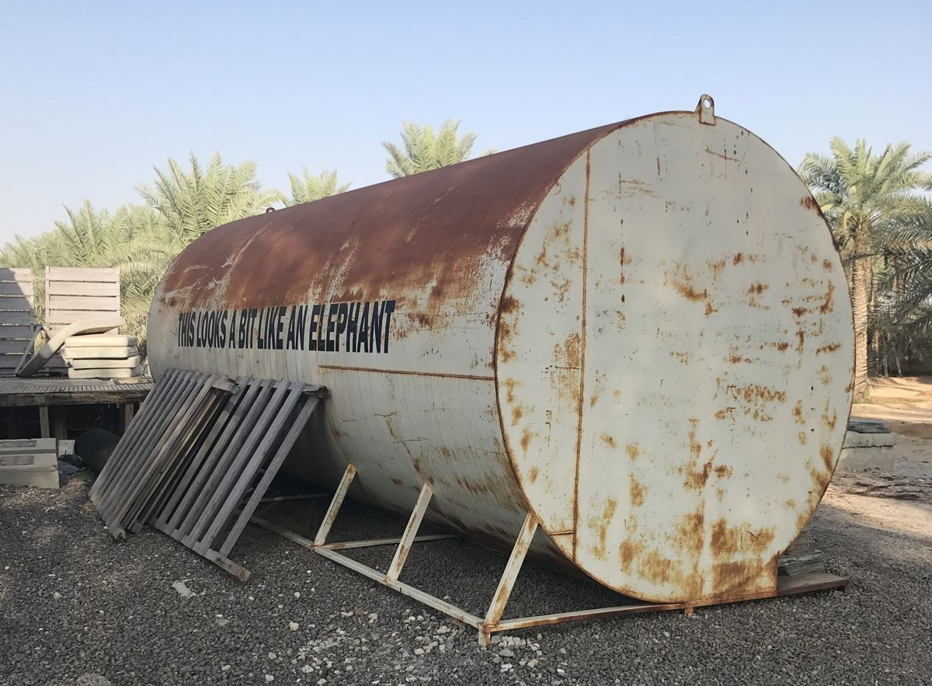
OTHERS - ( possibly available – owned by Vren )
Trailer
5 x 2.2 mts
Not registered
OIL TANKER - BIKE RACK
SECURITY CABIN

